Slide 1

Working with Assistants Part 7: Working with Runs

Slide 2
Brenda Cullerton
“She'd been killed by her own personal assistant, news that Charlotte believed had come as a terrible shock to everyone in the city except the thousands of other personal assistants who dreamed, daily, of doing the same thing.”

Slide 3



Notes:
https://www.youtube.com/channel/UC35ZpwldGw7ZJ5R-2sLijzw

Slide 4


Membership has its privileges
Notes:
https://www.youtube.com/channel/UC35ZpwldGw7ZJ5R-2sLijzw/join

Slide 5

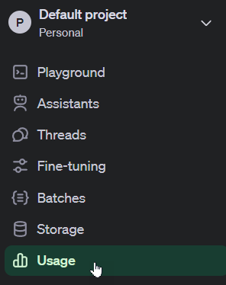
Watch your spending as you work with the API’s. Costs can get reasonably high if you aren’t careful.

Slide 6

Notes:
https://platform.openai.com/docs/models

Slide 7
Creating Assistants, Threads & Messages Review
Let’s Make Some More Objects!
Notes:
https://platform.openai.com/docs/api-reference/assistants/createAssistant

Slide 8
Demo: Creating Assistants Review
# Create an assistant.
assistant = client.beta.assistants.create(
model="gpt-4-turbo",
instructions="You are a helpful assistant.",
name="Run Tester Assistant",
metadata={
"holds_threads": "True",
"likes_threads": "True",
"holds_messages": "True",
"likes_messages": "True",
},
temperature=1,
top_p=1,
)

Slide 9
Demo: Creating Threads Review
# Create a thread using the OpenAI API and store it in a variable
# The metadata specifies a user identifier
thread_holding_messages = client.beta.threads.create(
metadata={
"user": "abc123"
}
)

Slide 10
Demo: Creating Messages Review
# Create a message in a specific thread using the client's message creation method.
message = client.beta.threads.messages.create(
thread_id=thread_holding_messages.id, # ID of the thread where the message will be posted
role="user", # Role of the entity posting the message
content="What is a penguin?", # The textual content of the message
metadata={"key": "value"} # Additional data associated with the message in key-value pairs
)

Slide 11
Understanding Runs
Finally, Some Action!

Slide 12
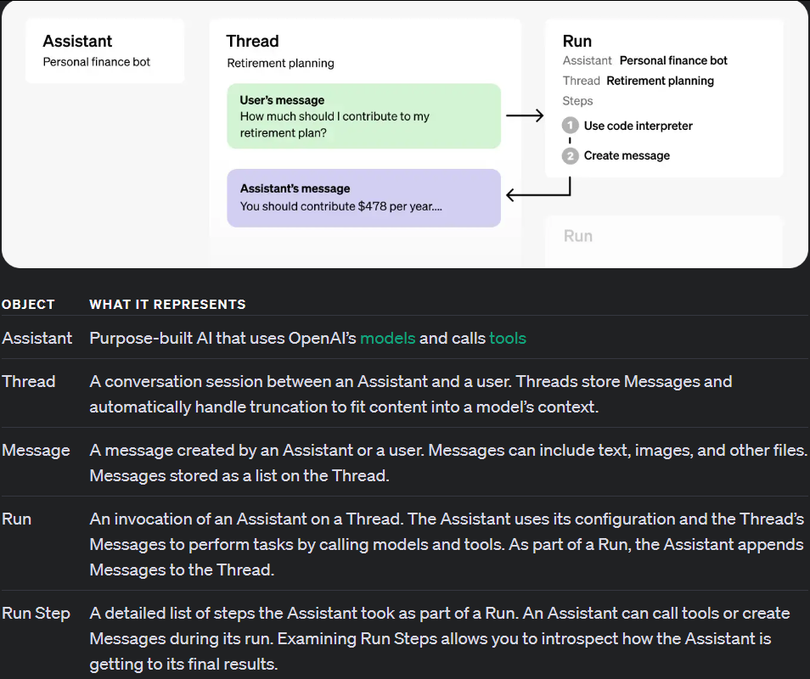
You Are Here
Notes:
https://platform.openai.com/docs/assistants/how-it-works

Slide 13

ASSISTANT ONE
THREAD ONE
ASSISTANT TWO
RUNS
MESSAGE ONE
MESSAGE TWO
MESSAGE THREE
ASSISTANT THREE
Notes:
https://platform.openai.com/docs/assistants/how-it-works/runs-and-run-steps
https://platform.openai.com/docs/assistants/overview

Slide 14
Creating Simple Runs (Non-Streaming)
Allons-y!
Notes:
https://platform.openai.com/docs/api-reference/runs/createRun

Slide 15
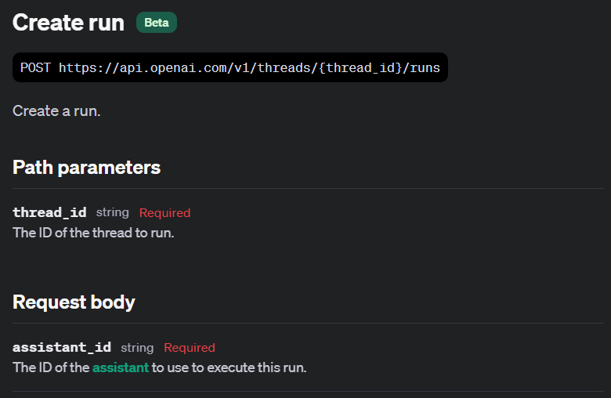

Slide 16
Demo: Creating a Simple Run
run = client.beta.threads.runs.create(
assistant_id=assistant.id,
thread_id=thread.id,
)
print(run)

Slide 17
Retrieving Run Status
What is the State of Our Run?

Slide 18
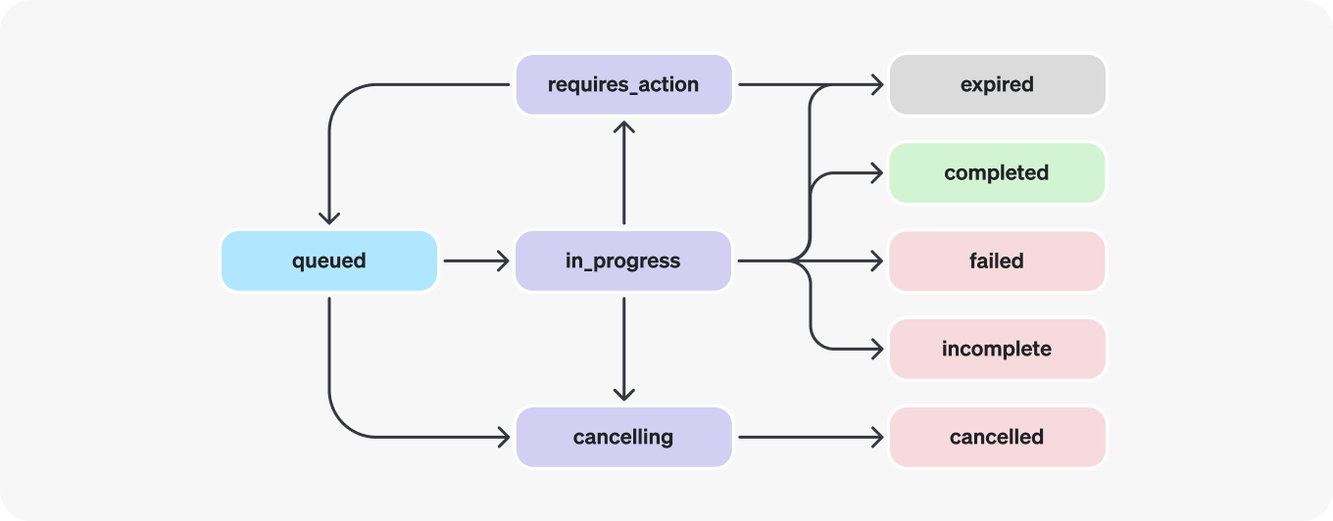
Run Lifecycle
Notes:
https://platform.openai.com/docs/assistants/how-it-works/run-lifecycle

Slide 19
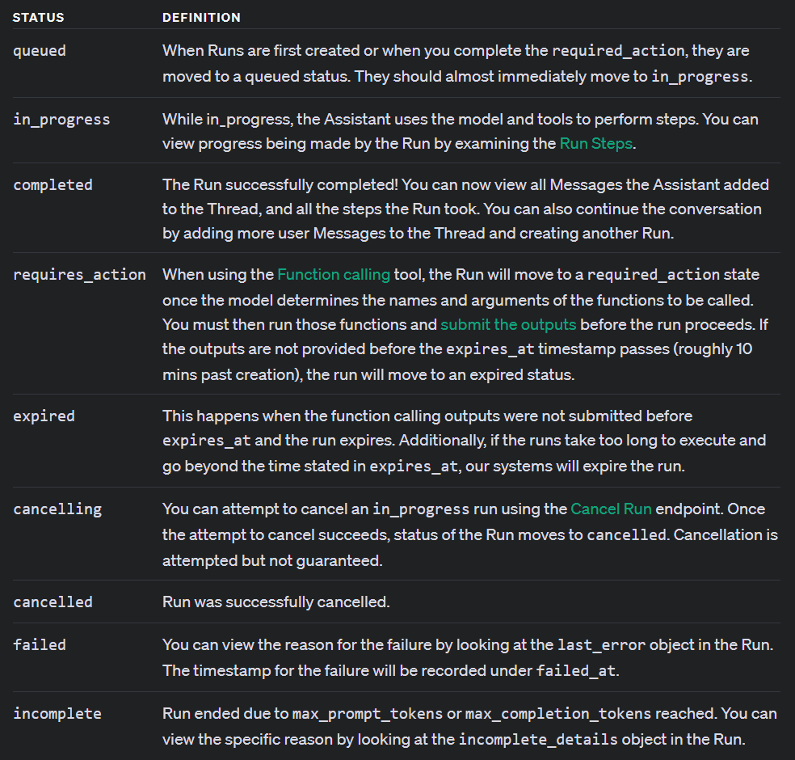

Slide 20
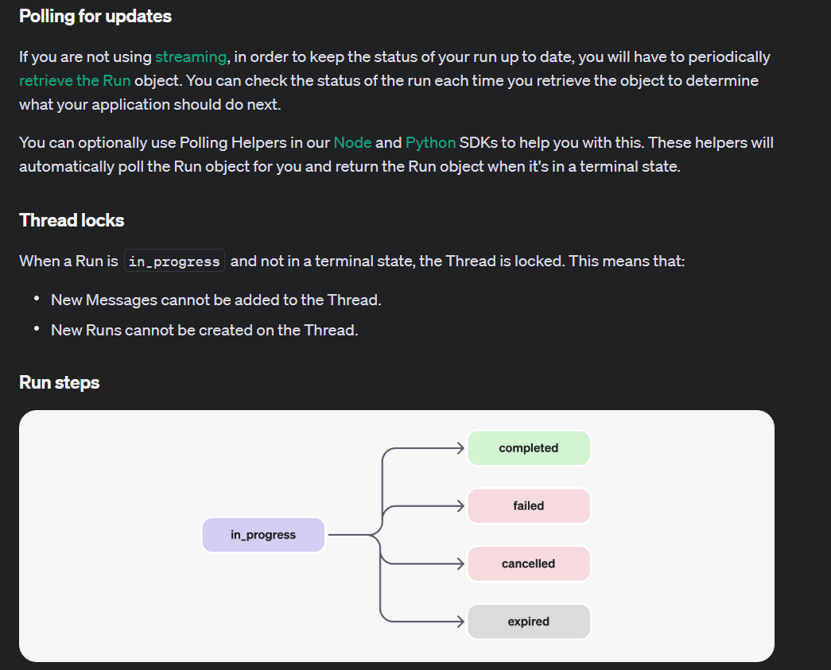
Notes:
https://platform.openai.com/docs/assistants/how-it-works/polling-for-updates

Slide 21
Demo: Getting the Run Status Manually
runstatus = client.beta.threads.runs.retrieve(
thread_id=thread.id,
run_id=run.id,
)

Slide 22
Demo: Getting the Run Status Automatically
auto_run_and_poll = client.beta.threads.runs.create_and_poll(
thread_id=thread.id,
assistant_id=assistant.id,
)

Slide 23
Creating Simple Runs (Streaming)
Row, row, row your boat…
Notes:
https://platform.openai.com/docs/api-reference/runs/createRun
https://platform.openai.com/docs/assistants/overview/step-4-create-a-run
https://platform.openai.com/docs/api-reference/assistants-streaming/events

Slide 24
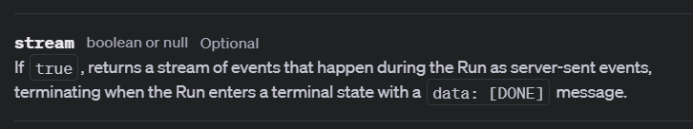

Slide 25
Demo: Creating a Simple Streaming Run
# Create a new run with the stream option set to True
# Attempt to create a new run
stream_run = client.beta.threads.runs.create(
thread_id=thread.id,
assistant_id=assistant.id,
stream=True
)

Slide 26
Dealing with Thread Locks
Teaching Threads to Wait Their Turn

Slide 27
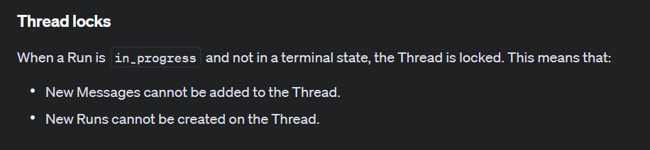
Notes:
https://platform.openai.com/docs/assistants/how-it-works/thread-locks

Slide 28
Demo: Thread Lock Notification
# Function to check if there is an active run
def check_active_run(thread_id):
try:
# Fetch runs for the thread and check their status
active_runs = client.beta.threads.runs.list(thread_id=thread_id)
for run in active_runs.data:
if run.status in ["in_progress", "queued"]:
return run.id
return None
except OpenAIError as e:
print(f"Failed to check runs: {str(e)}")
return None

Slide 29
Demo: Waiting Your Turn
# Wait until there is no active run
while check_active_run(thread.id):
print("Waiting for the existing run to complete...")
time.sleep(10) # Wait for 10 seconds before checking again
# Once no active runs are detected, proceed to create a new run
try:
print("Creating a new run...")
stream_run = client.beta.threads.runs.create(
thread_id=thread.id,
assistant_id=assistant.id,
stream=True
)

Slide 30


